Slide 1
CE2101 Example Class 2
Done by: Kah Hoa, Rui Hong, Yan Qi

Slide 2
Implementation with Adjacency Matrix and Array
Dijkstra Algorithm

Slide 3
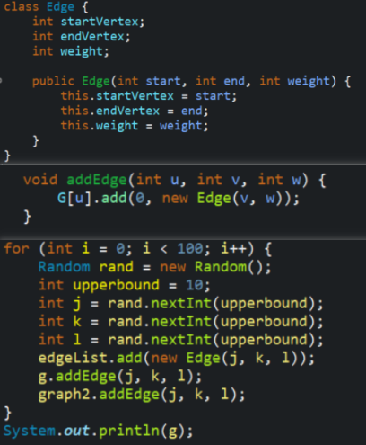
Testing with various array sizes and edges
Upper Bound is used to limit the value for the edges
Edges are added into the array with random values for the start point, end point and weight

Slide 4
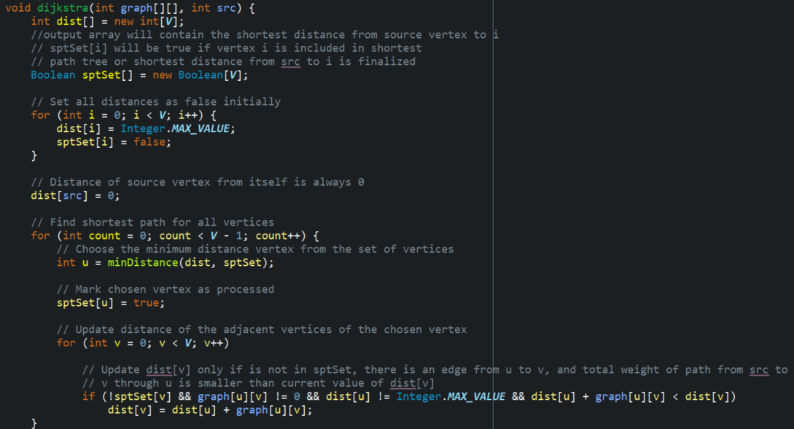
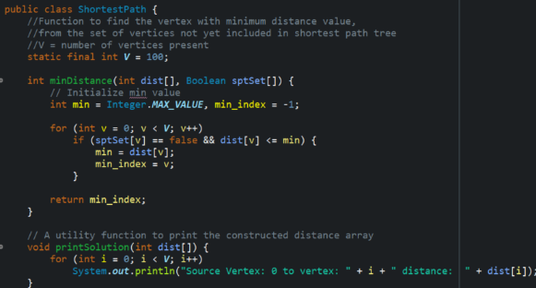
Implementing Djikstra’s algorithm

Slide 5
Time complexity of Djikstra’s algorithm adjacency matrix.(Theory)
For n number of vertices, there are n iterations of getting the minimum distance from the nearest unvisited vertex in the matrix, requiring O(N).
Marking of each node as visited requires constant time.
Updating of the min adjacent vertex distance requires another n iterations since for each vertex the values in that row are checked individually , thus requiring O(N).
Keeping track of the parent node requires constant time.
Thus total time complexity is O(N²) since in N iterations, 2 times of O(N) is required.

Slide 6
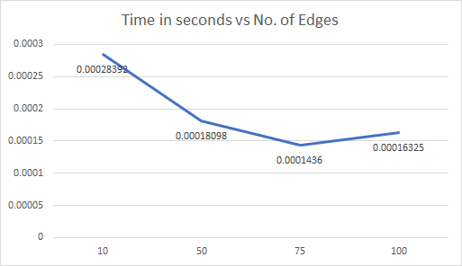
Performance of algorithm for 10 vertices

Slide 7
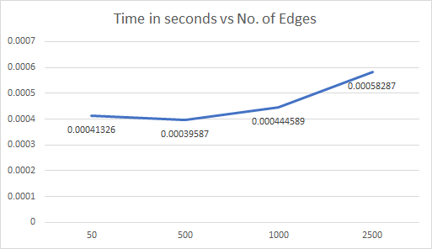
Performance of algorithm for 50 vertices

Slide 8
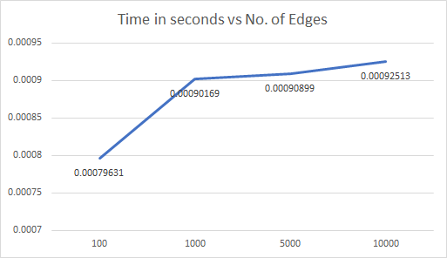
Performance of algorithm for 100 vertices

Slide 9
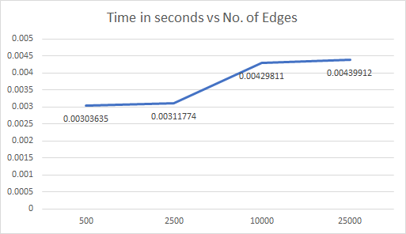
Performance of algorithm for 500 vertices

Slide 10
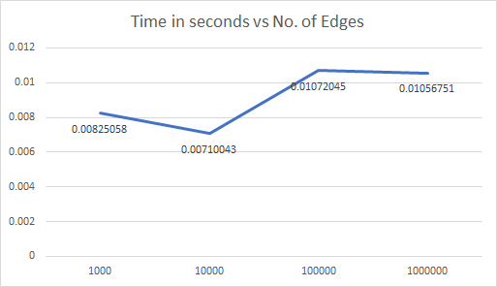
Performance of algorithm for 1000 vertices

Slide 11
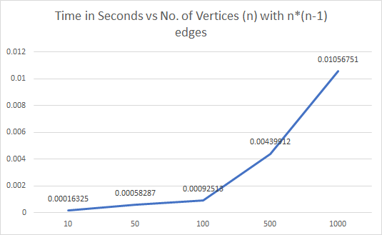
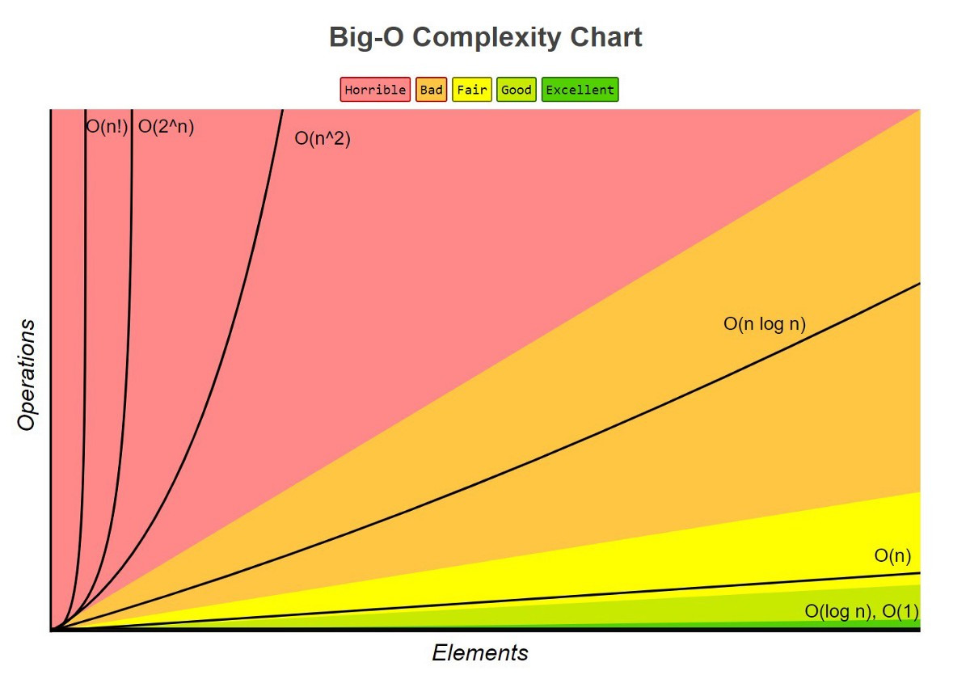
Overall performance of Djikstra’s algorithm for number of vertices with n*(n-1) edges vs time(s).
Theory and practical time complexity both reflect O(N²)

Slide 12
Implementation with Adjacency List and Min Heap
Dijkstra Algorithm

Slide 13
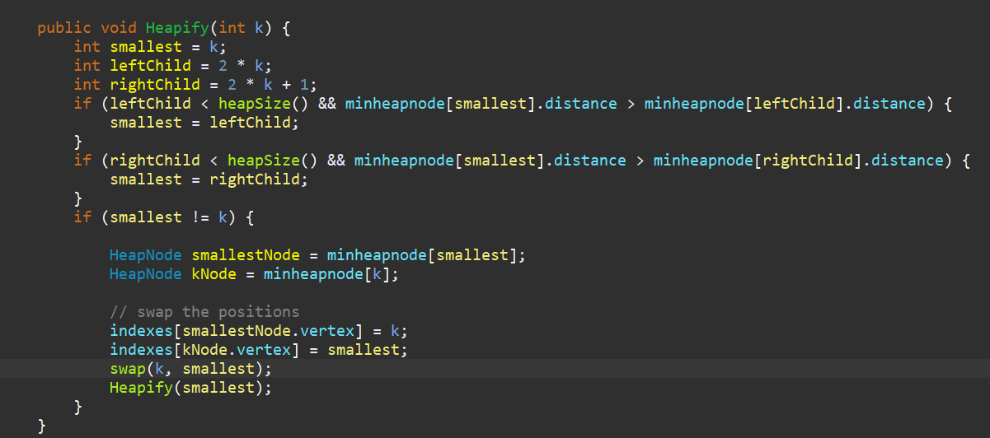
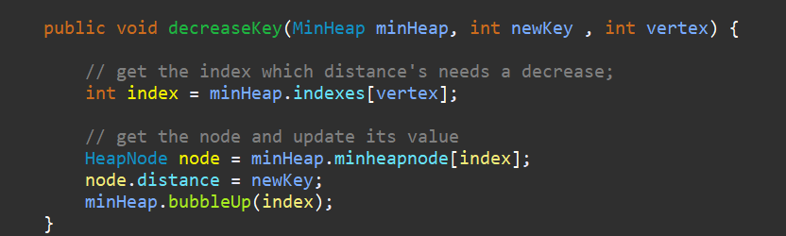
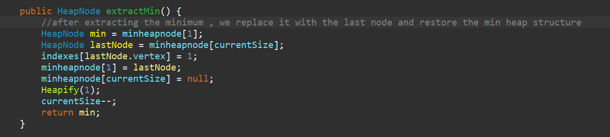
Min Heap structure
Used as a priority queue
extractMin() is used to get the smallest distance each time
DecreaseKey() is used to update the distance if needed
Utility functions(heapify()) to restore the min Heap structure are also required

Slide 14
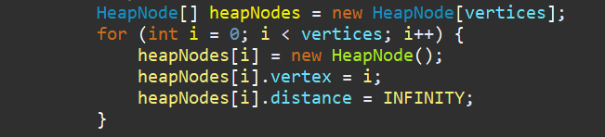
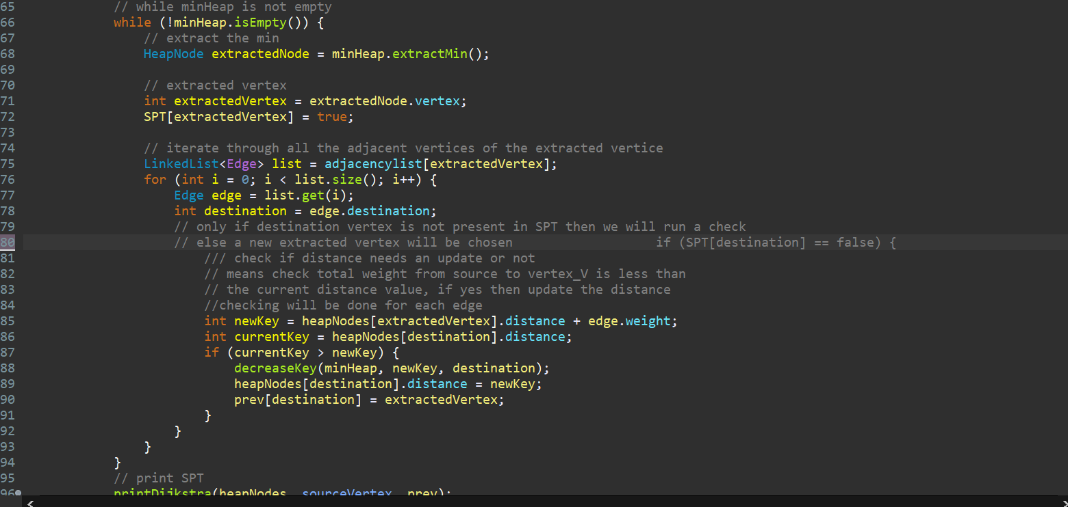
Implementation of Algorithm
Algorithm will run until the min Heap is empty
Each time a min Heap node is process , it will be marked as visited.
Similar to the previous array implementation but instead of updating the array , we update the min Heap node each time we find a shorter distance

Slide 15
Analysing the theoretical time complexity
As each vertex will be inserted and extracted from the priority queue only once
Assuming that there are V vertices , we will do these V number of times
As we are using a min Heap as a priority queue , each insert/extract will only take O(log V) time.
Hence for this part , we will take O(V log V)

Slide 16
Analysing the theoretical time complexity
We move on the updating of shortest distance.
Everytime we choose a vertex , we will update the shortest distance for all its neighbours
DecreaseKey() is used to do so and each operation will take O(log V) time
This process will repeat for the number of edges , E.
Hence , this part will take O(E log V)

Slide 17
Analysing the theoretical time complexity
Overall Complexity = O(V log V) + O(E log V)
= O((V+E) log V)

Slide 18
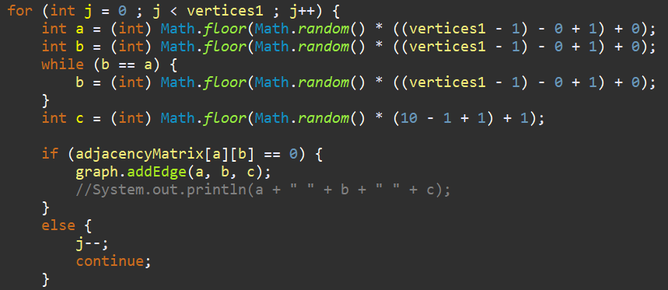
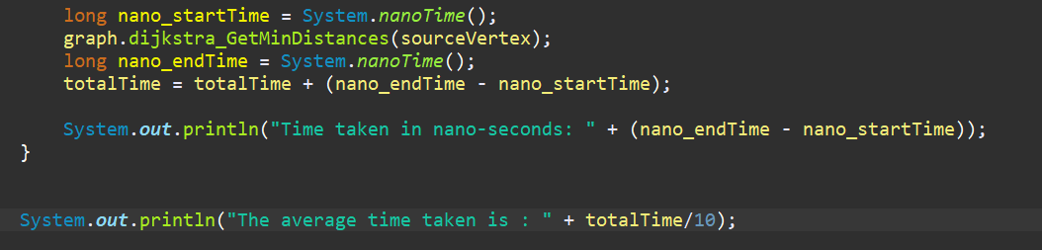
Analysing time complexity empirically
Test out algorithm with varying vertex size and edges and time taken is plotted out
Each graph is randomly generated
For each vertex size , average time taken is taken from 10 runs of the algorithm.

Slide 19
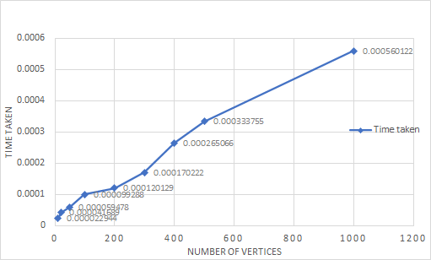
Analysing time complexity empirically

Slide 20
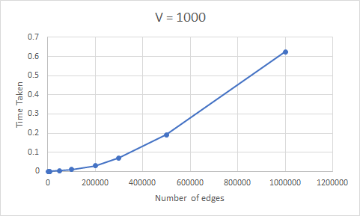
Analysing time complexity empirically

Slide 21
Analysing time complexity empirically

Slide 22
Comparison between the two implementation
Dijkstra Algorithm

Slide 23
Time Complexity
O(Dijkstra) = O(V²)
O(Dijkstra) = O((E + V) logV)

Slide 24
Time Complexity
Thus, from the time complexity equations, CPU timing is dependent on both V and E
Hence, we tested out different values of E with respect to V to compare which implementation is better in what scenarios
For each V: edge used is from V-1 to V * (V-1)
Connected graph: requires at least V-1
Completed graph: each vertex is connected to (V-1) edge

Slide 25
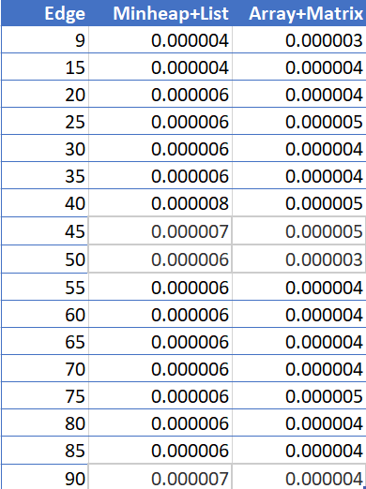
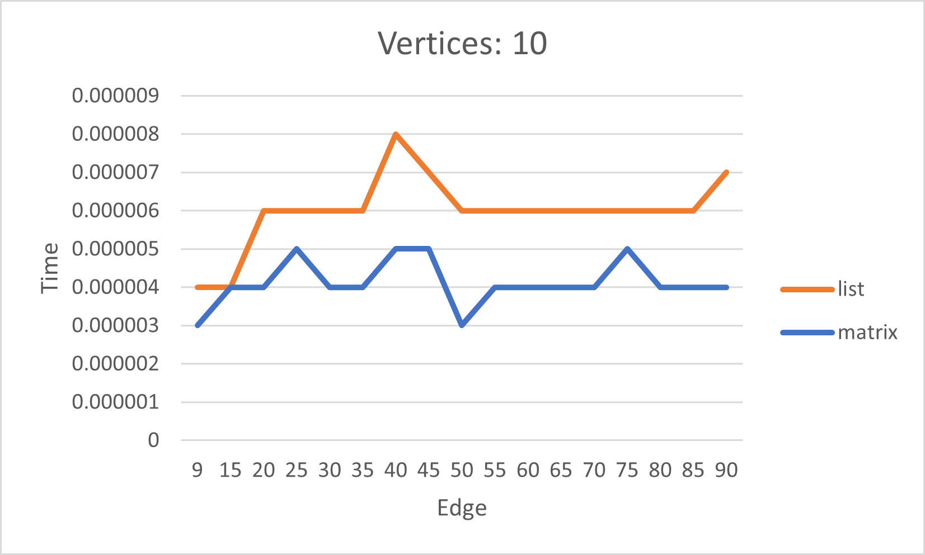
Number of Vertex = 10

Slide 26
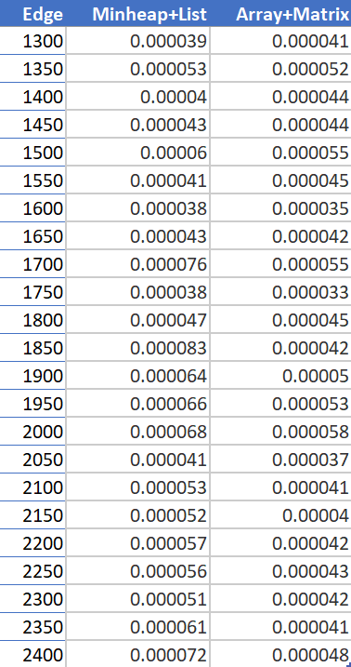
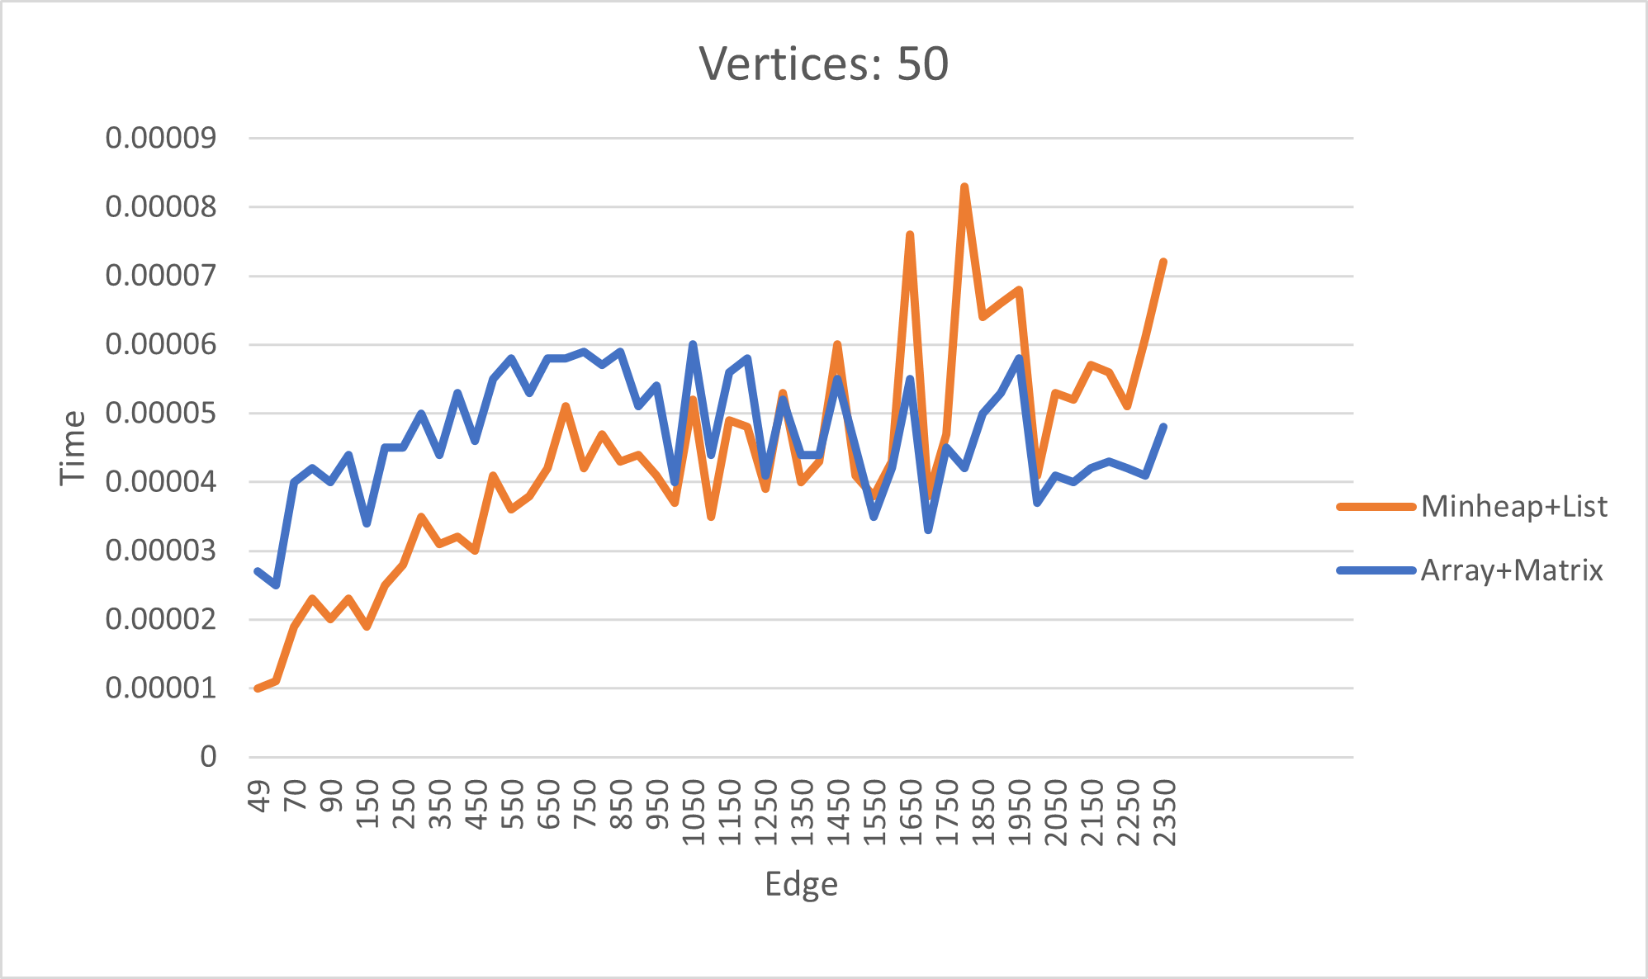
Number of Vertex = 50

Slide 27
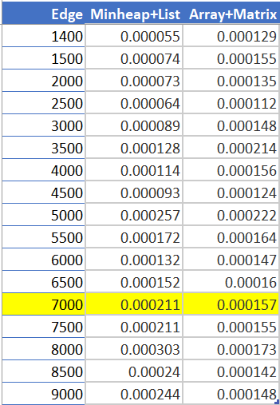
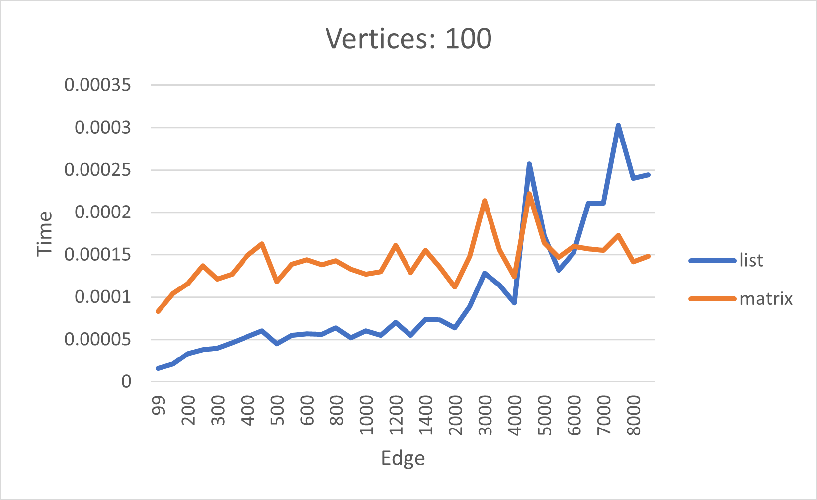
Number of Vertex = 100

Slide 28
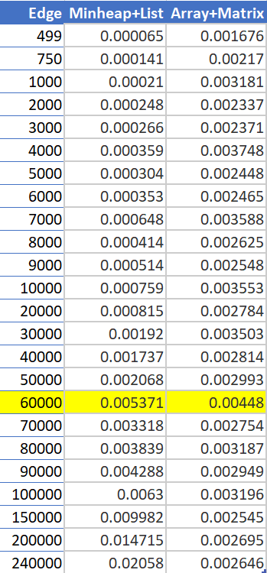
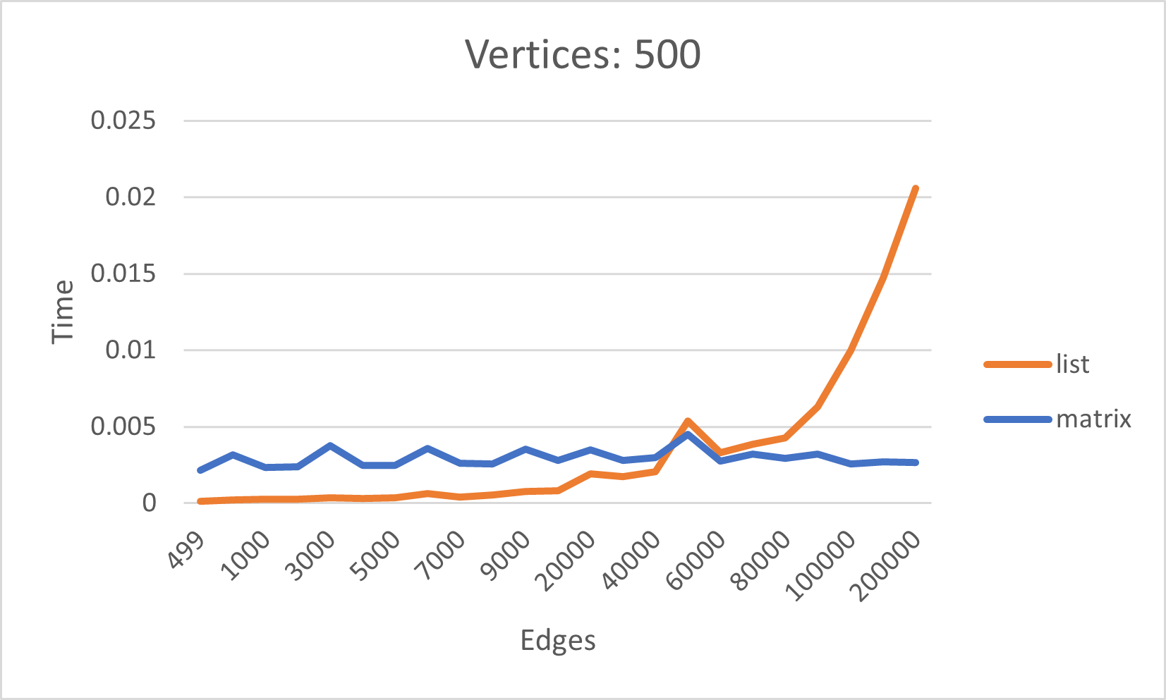
Number of Vertex = 500

Slide 29
Conclusion
Array + Adjacency Matrix will work well with small V regardless of size of E
For large V, (in this case 50 and more), Min Heap + Adjacency List will be better when E is nearer to min value
However, as E increases, the CPU timing is much greater than that of Array + Adjacency Matrix
Array + Matrix should also be used when both V is large and E is nearing max value of E as seen from the graphs

Slide 30
Conclusion
Array + matrix should be used when value of E is unknown and V is large as rate of increase of CPU timing for Minheap + List is greater than Array + Matrix, and thus, CPU timing will be more predictable

